Slide 2
Flat Knitting
NOT ONLY A TREND

Slide 3
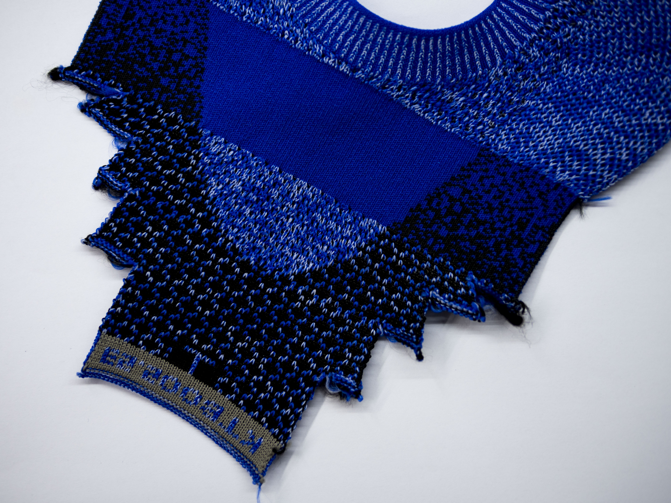
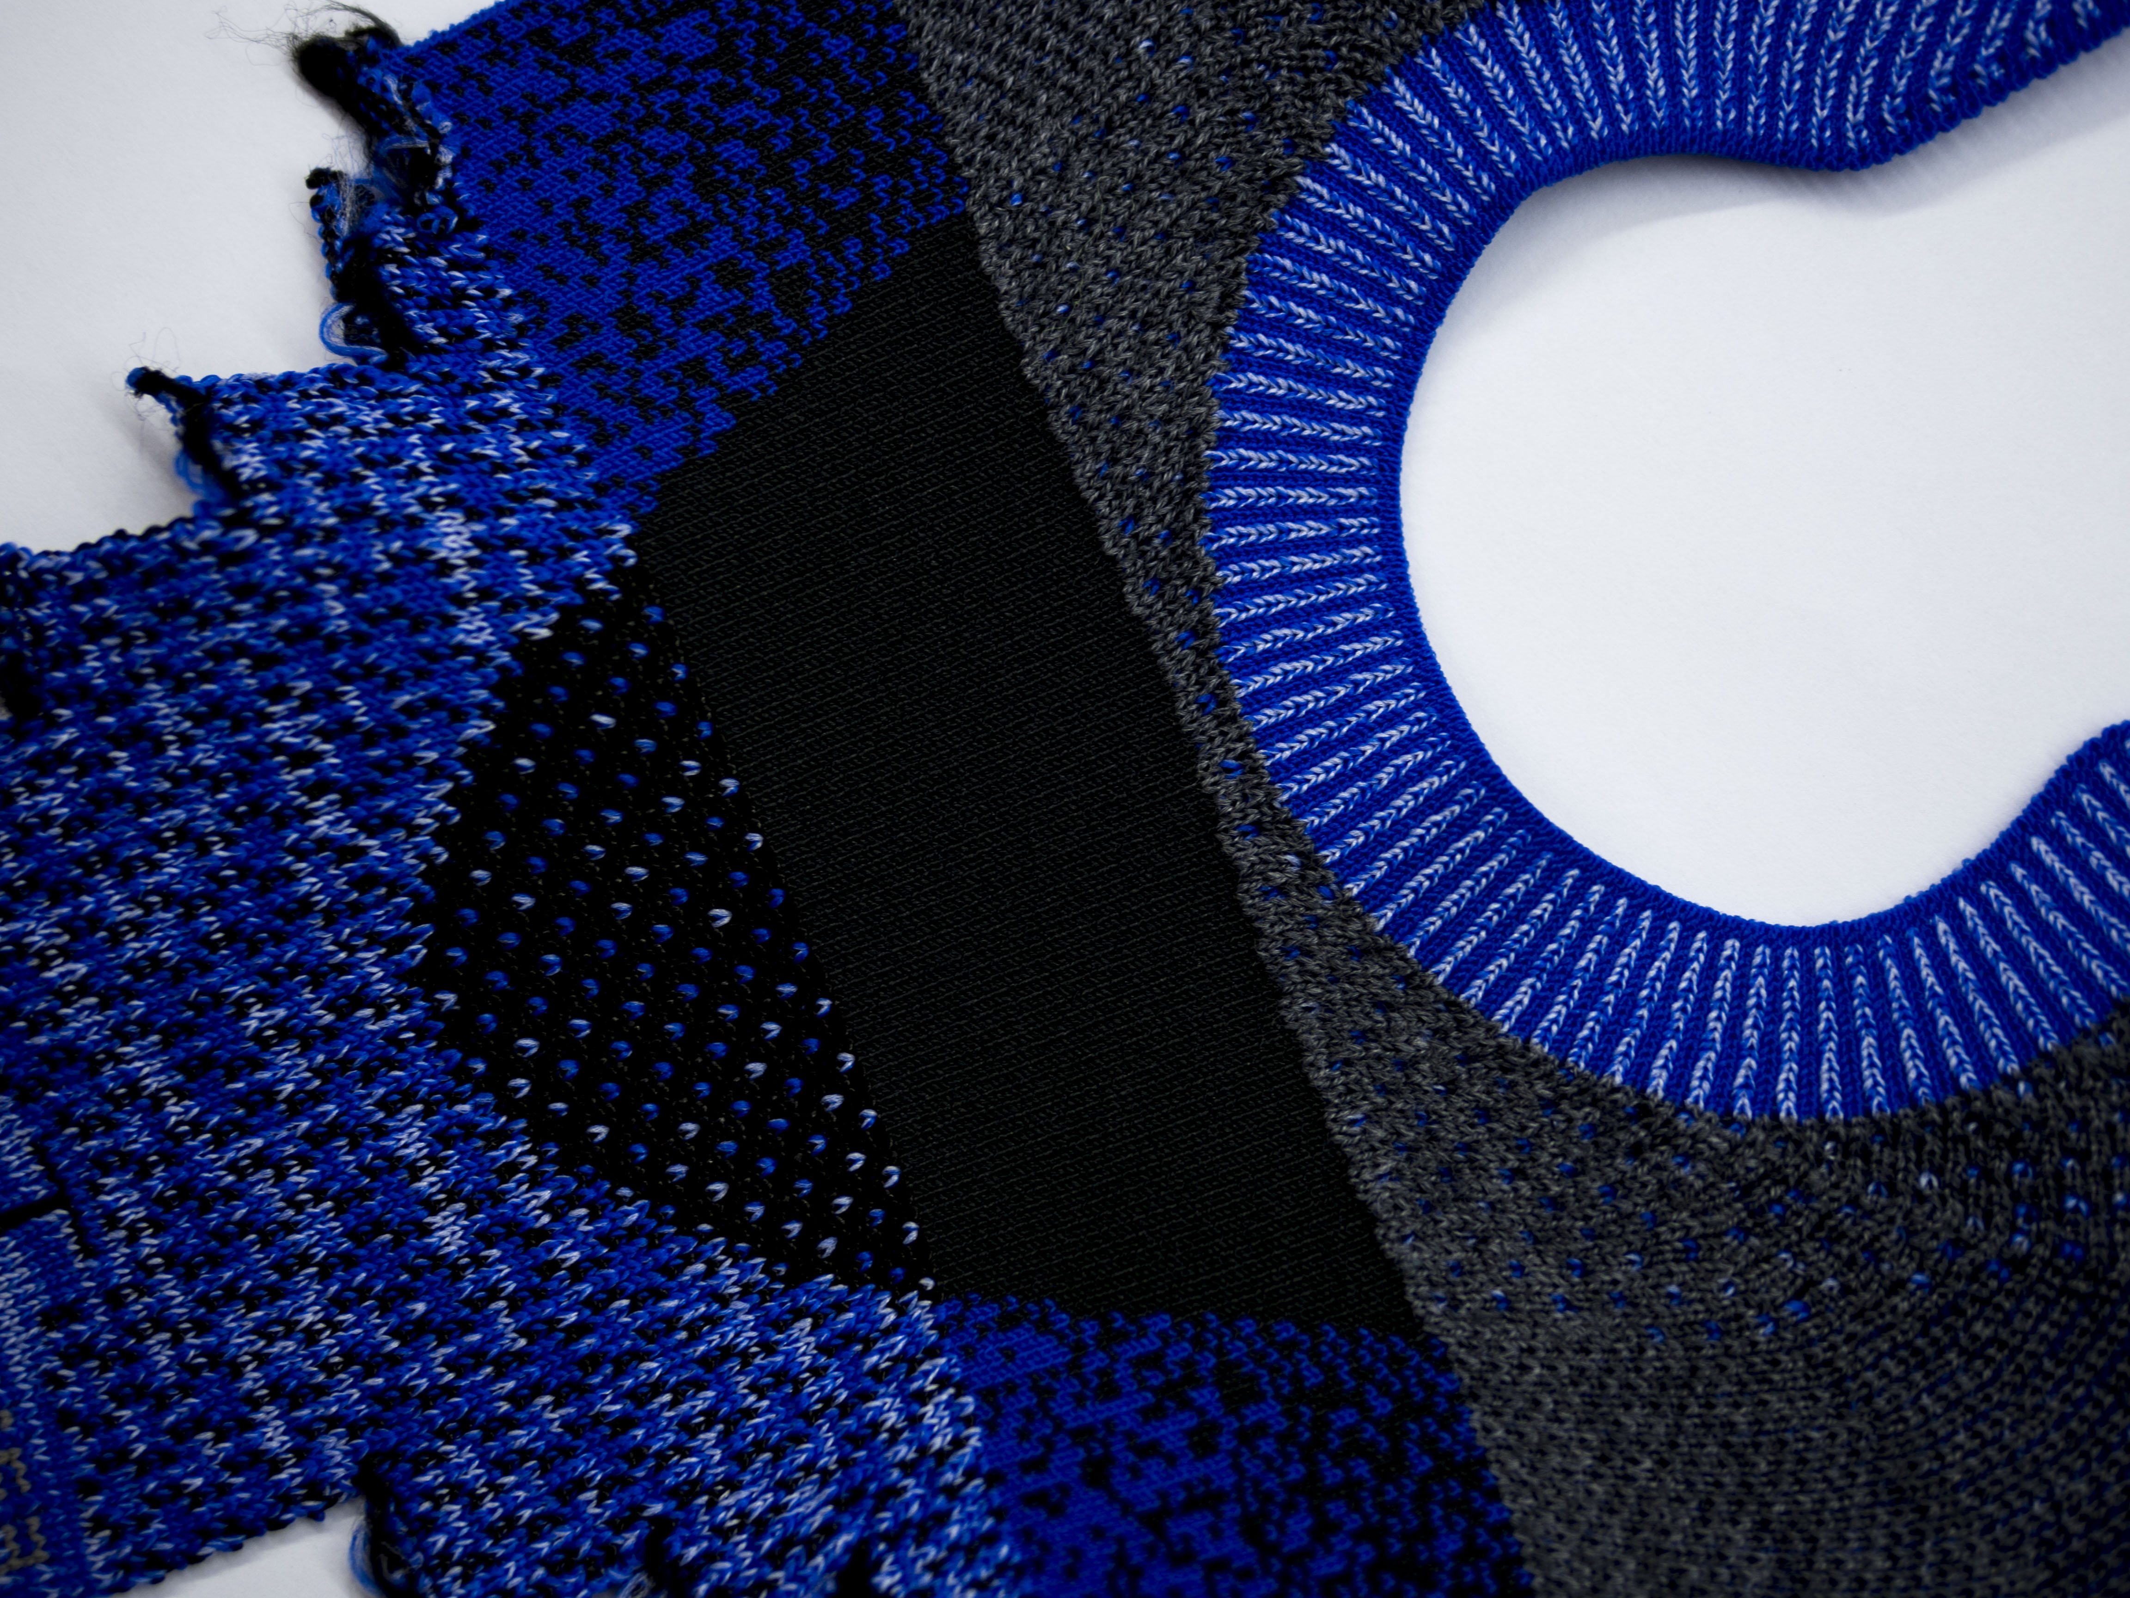
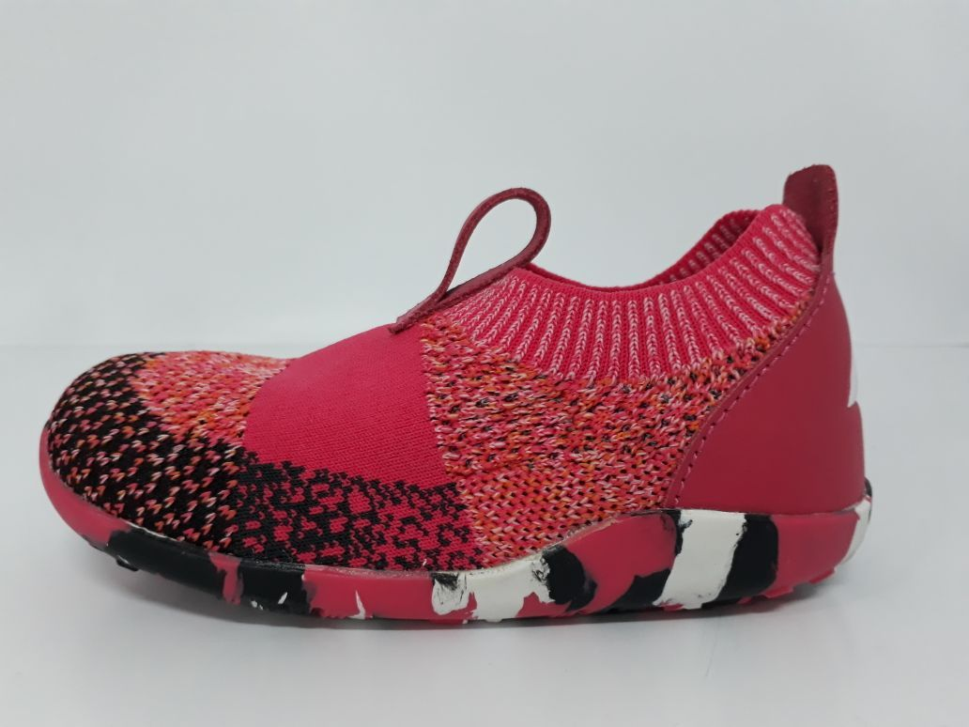
Creating lightweight yet sturdy shoes has obsessed the entire footwear industry for decades. The original concept was to create a shoe that felt like a sock but had the strength and support of the best traditional shoes.
With this flat knitting technology the technitians use a software instructs the machine what to do in every section of the upper. The material, the structures or the stretch between the weaves can be changed so that the flat knit becomes a multi funtional textile.
Instead of being knitted as a big roll of textile that has the same material and properties all over, it is actually knitted piece by piece as a engineered upper with different areas that fullfill different funtional requirements.

Slide 4
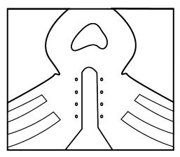
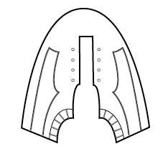
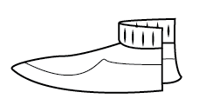
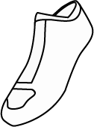
SQUARE KNITTING
•This is the simplest in the developing stage the quickest to knit in the machine
•Cutting Required – lining or bounding
SHAPE KNITTING
•Not require extra cutting process, safe material but takes more time to develop and to knit. Can be done in stairs, still need cutting.
3D KNITTING
•This the most complicated one in the developing stage and requires a side view paper pattern. Need to be aware of the pivot lines.
SOCK KNITTING
•This is our own innovation patented technique to
Create a sock on a flat knitting machine. This allows us to perfectly follow the last shape. Quite expensive because it takes too much time.
Knitting style
This are the most the most common ways of developing an upper.

Slide 5
Circular Knitting
Only one color int he heel
Need to make a seam

Slide 6
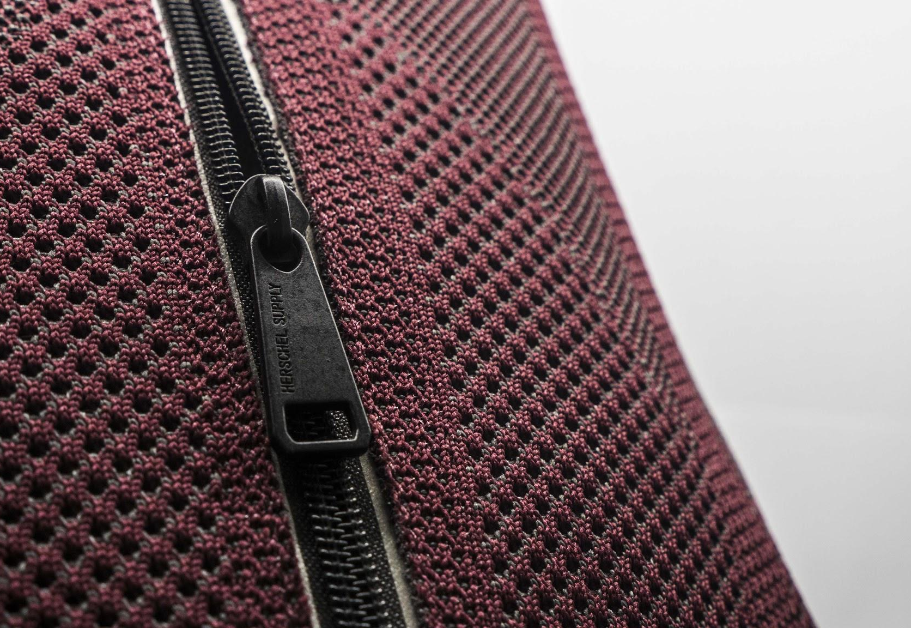
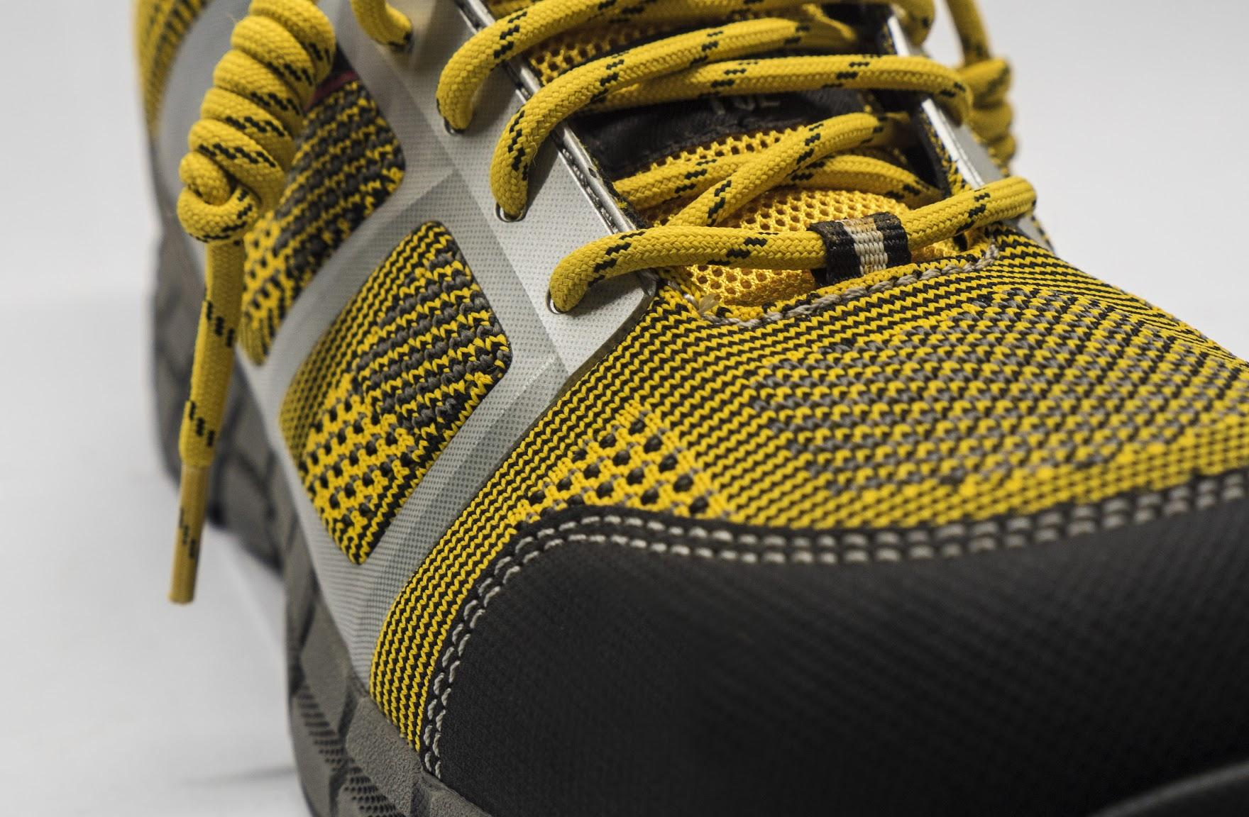
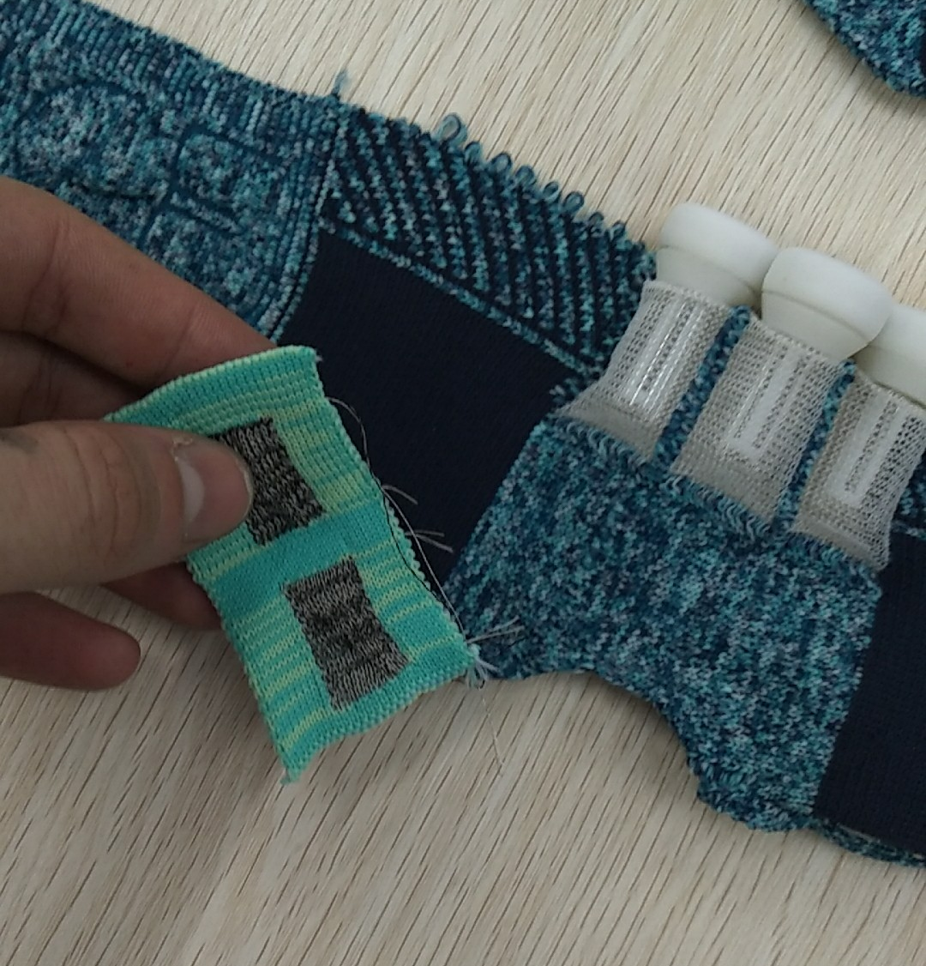
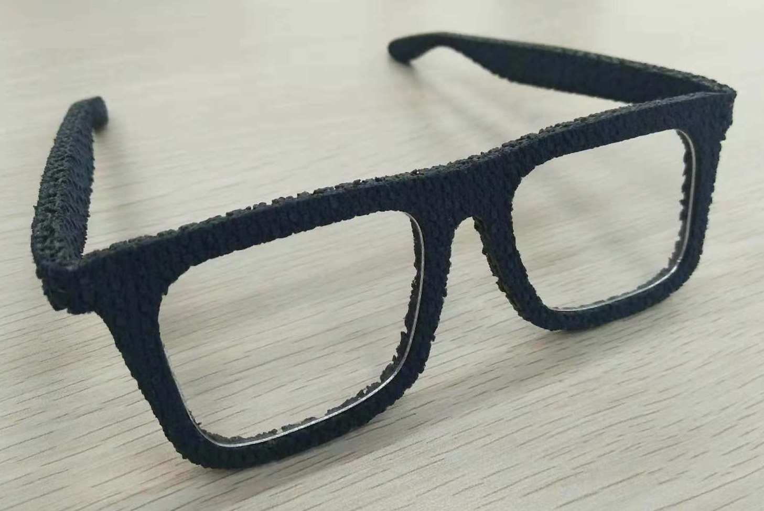
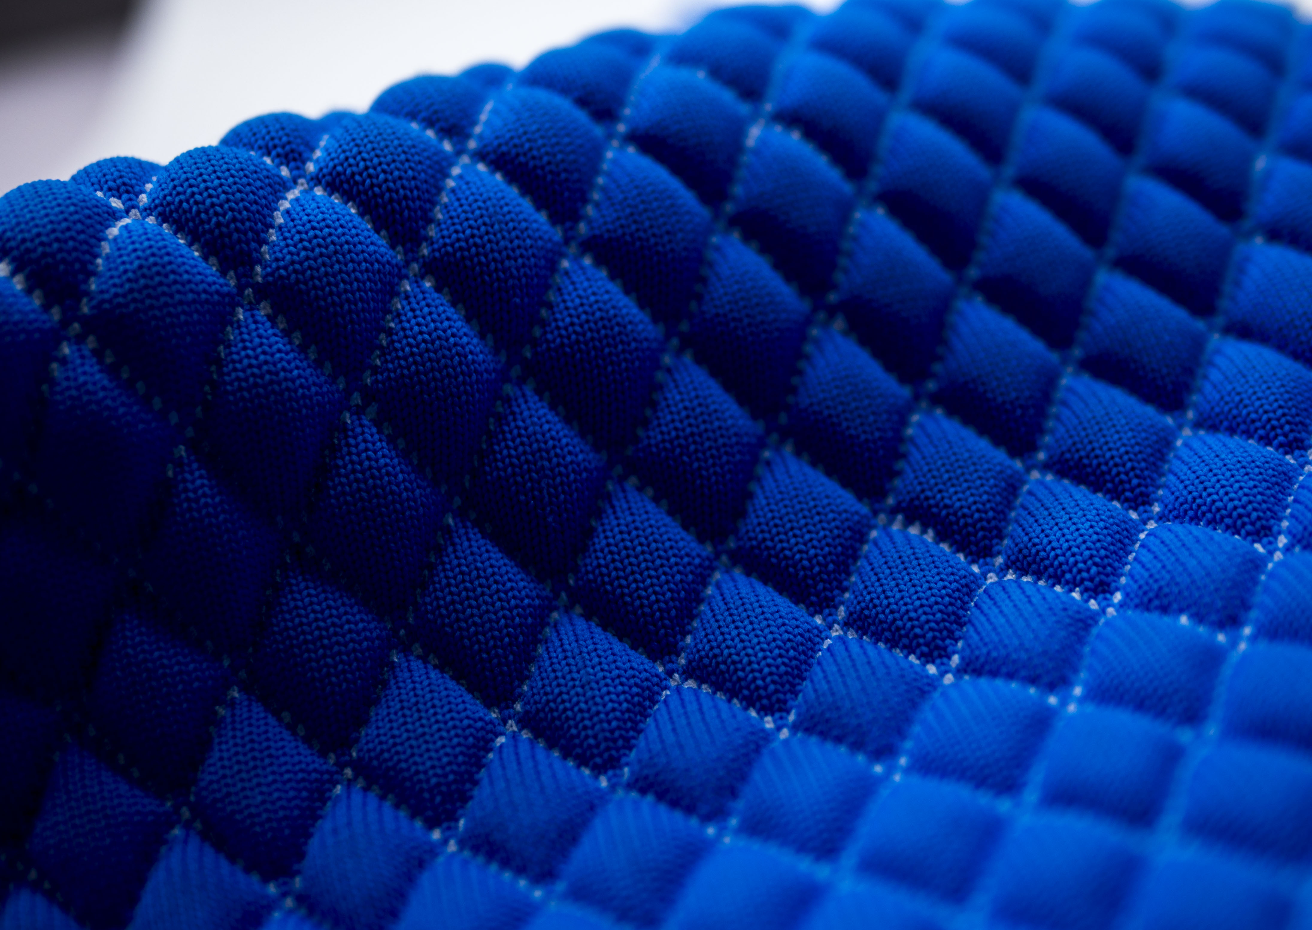
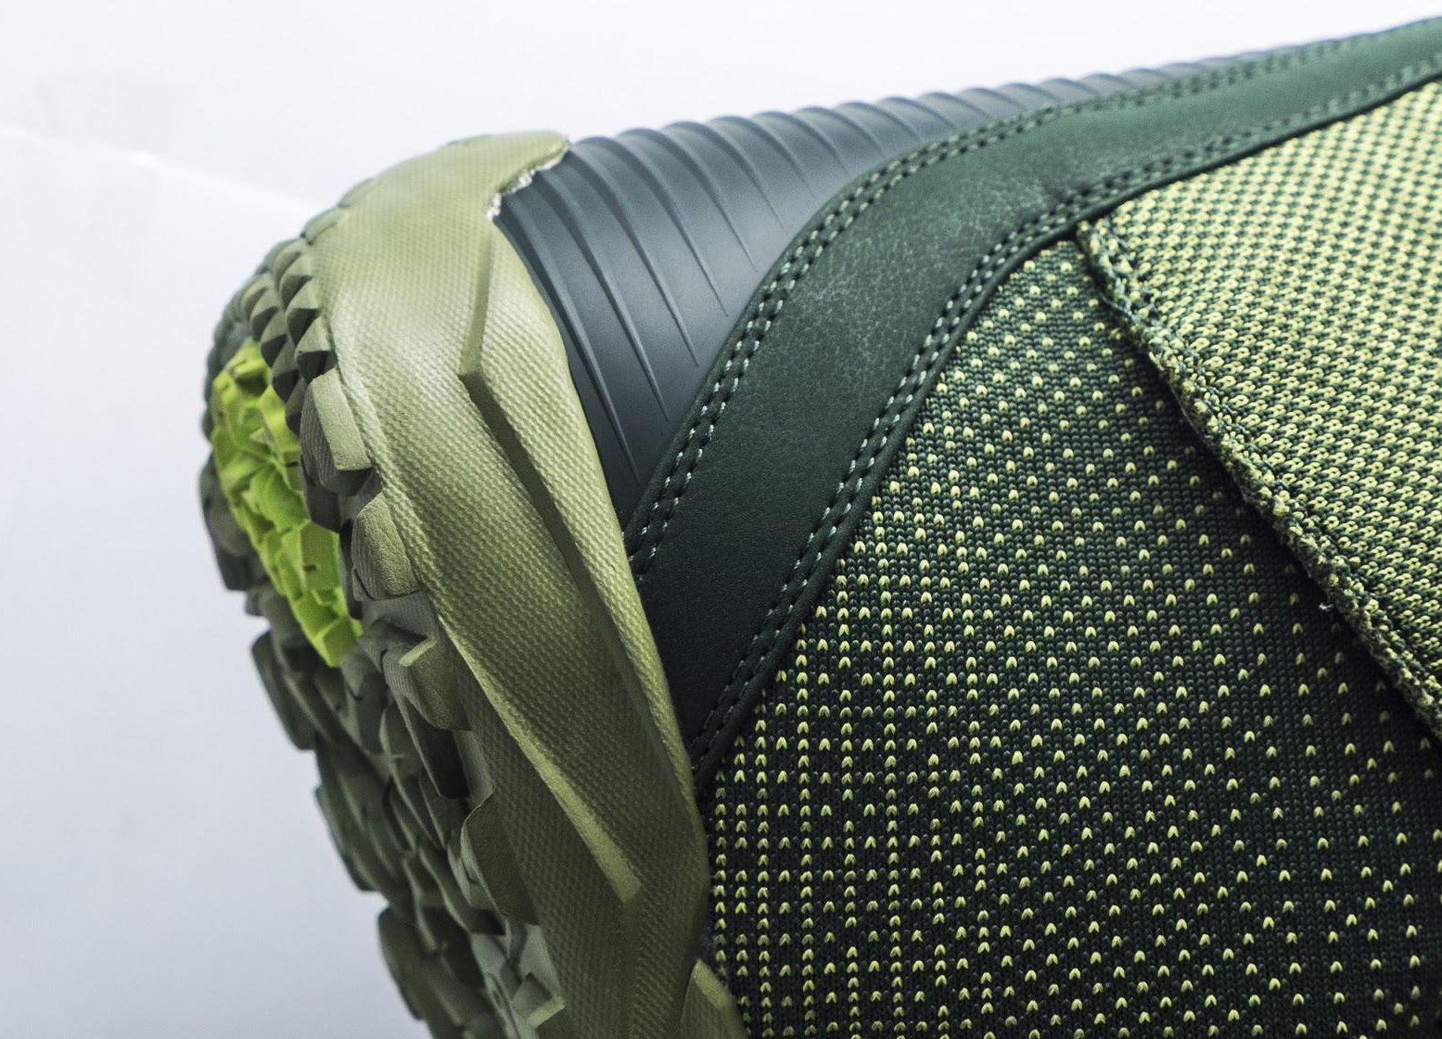
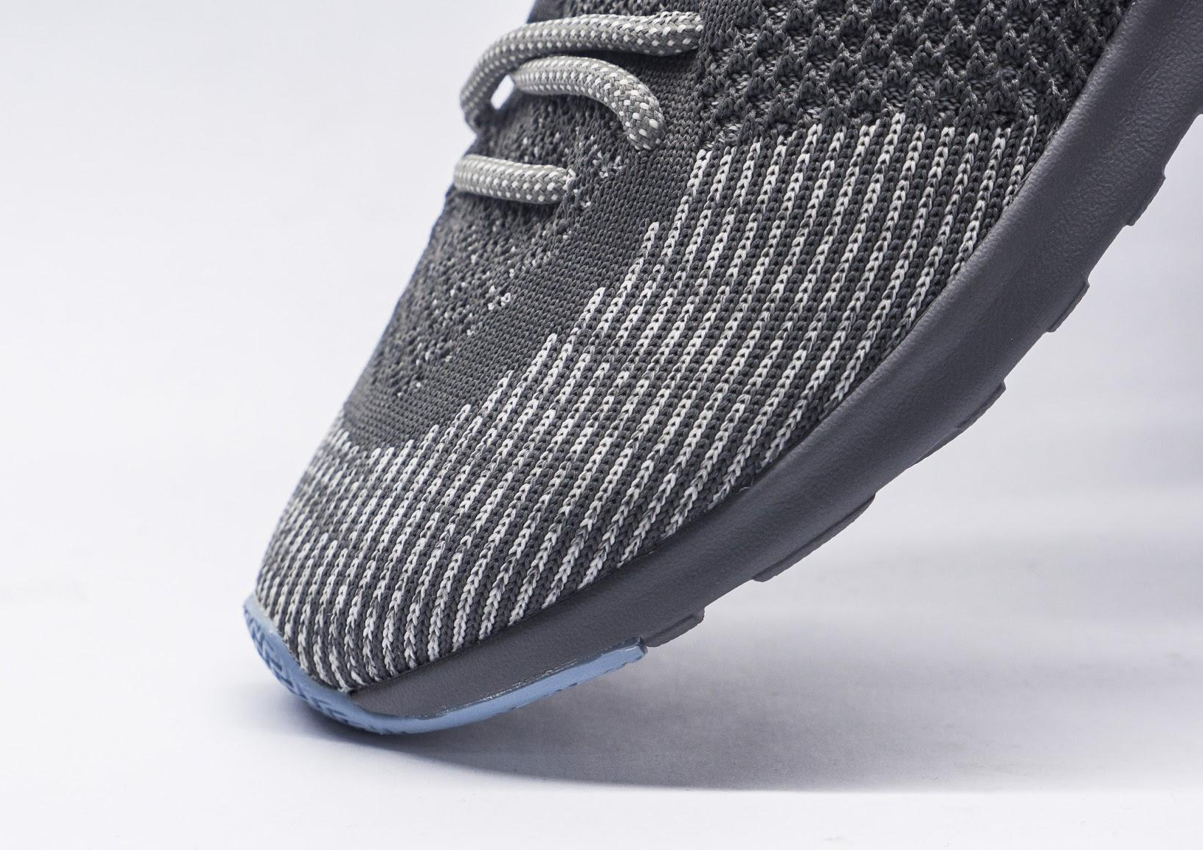
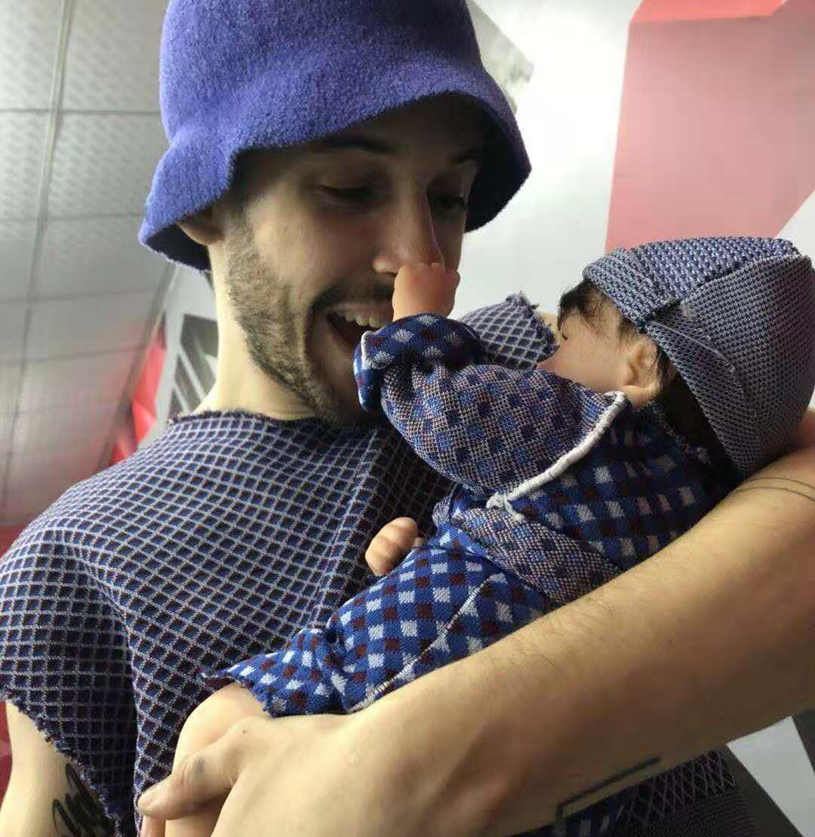
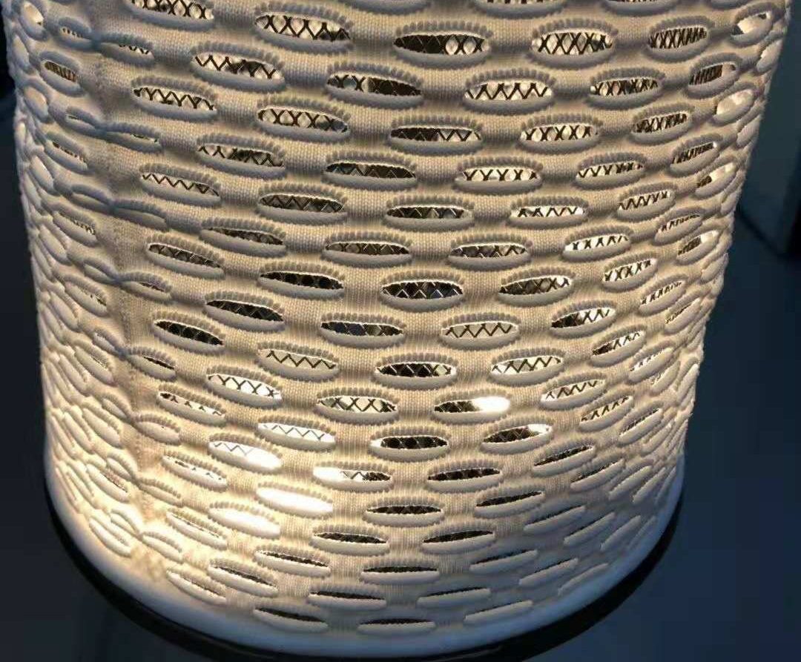
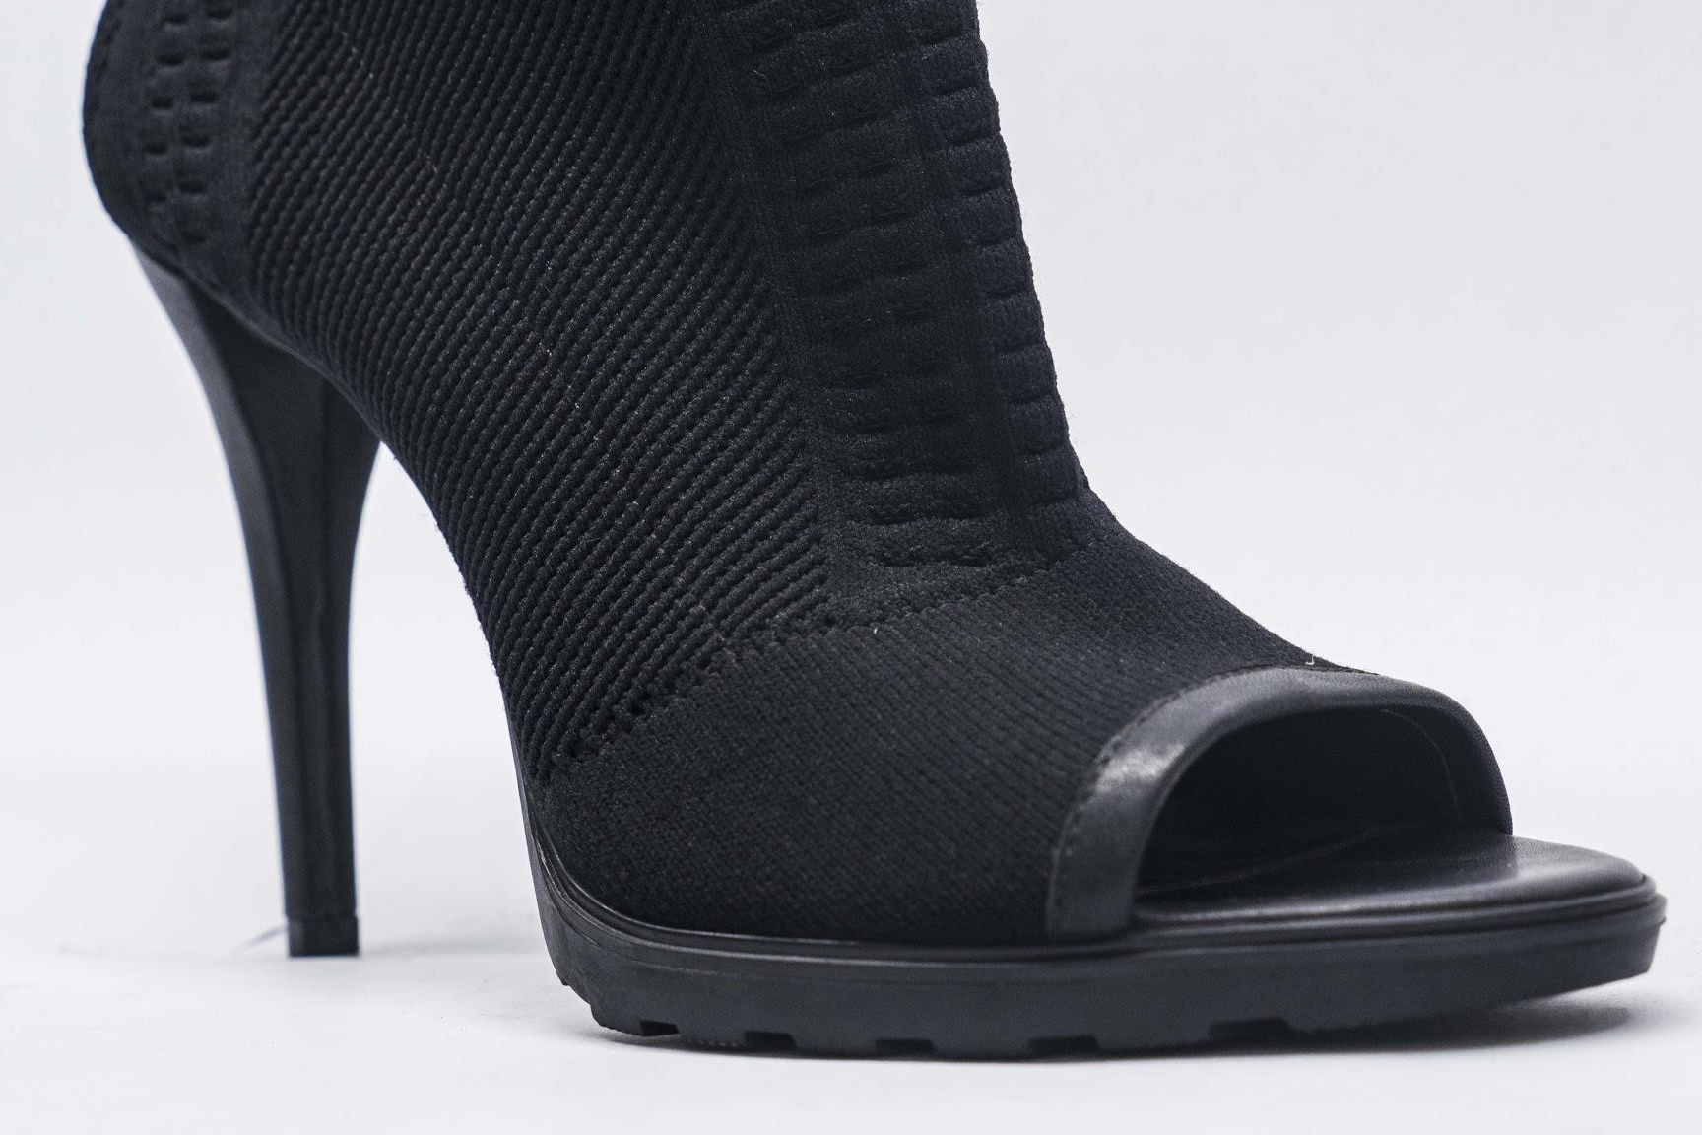
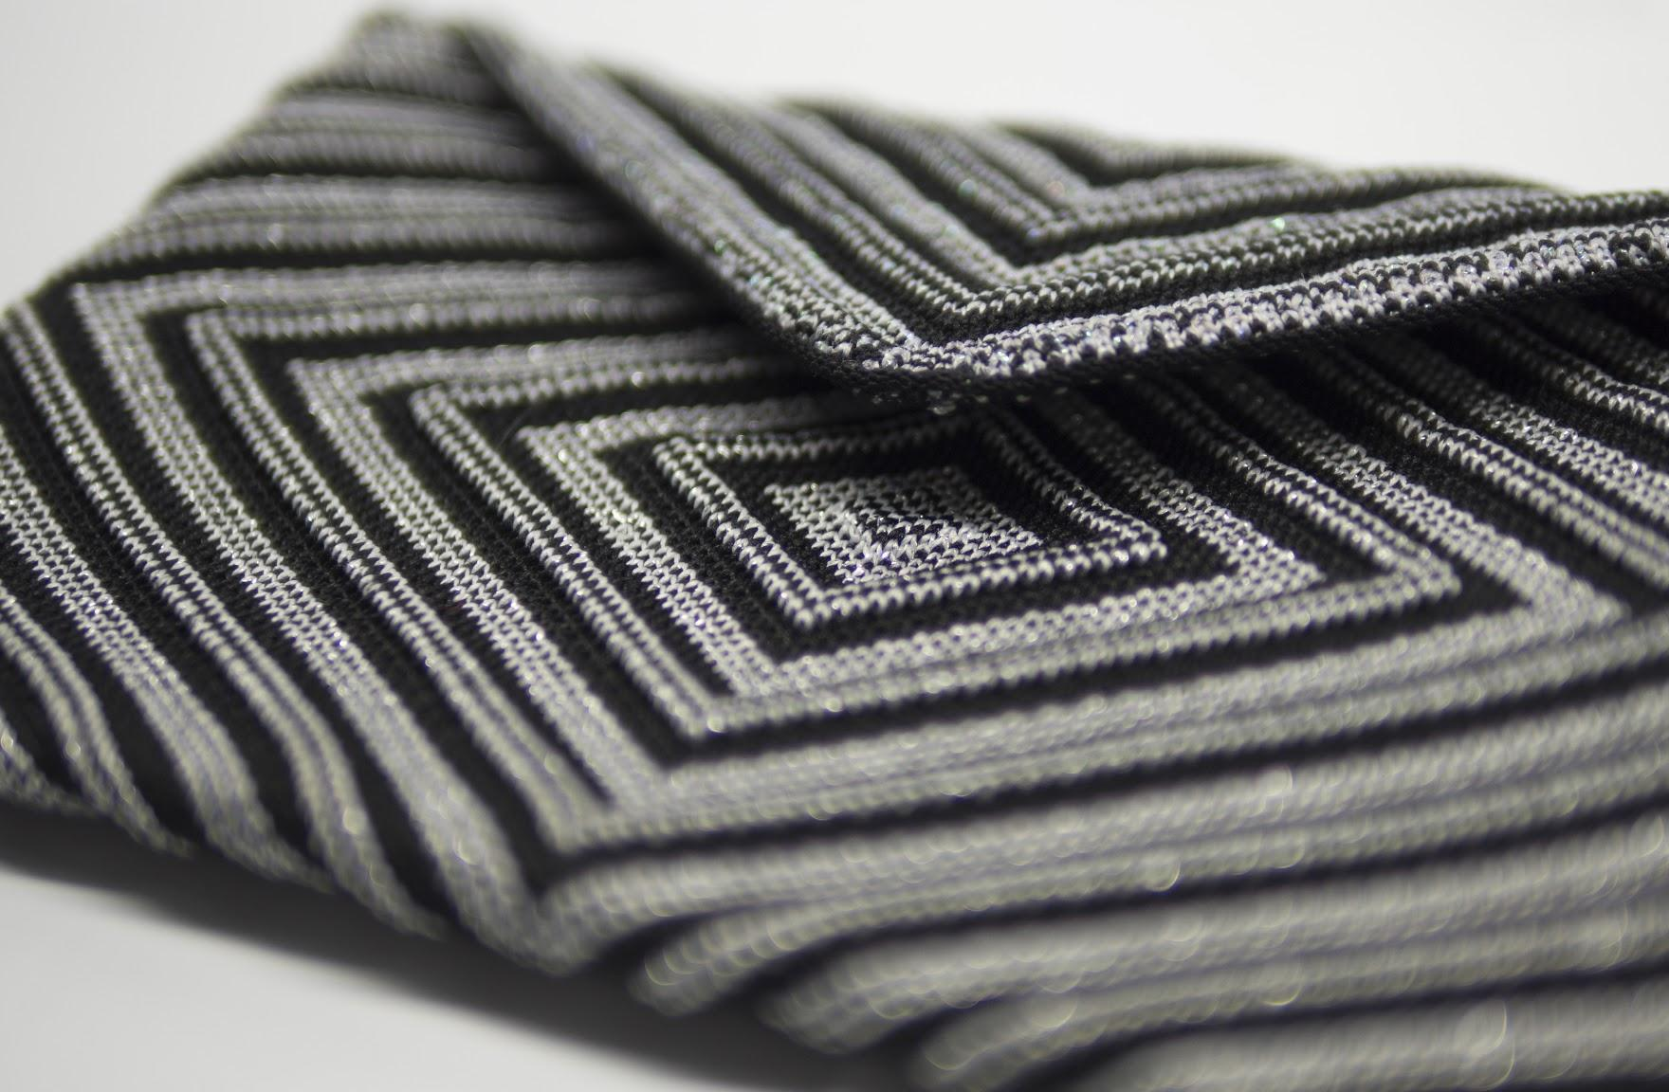
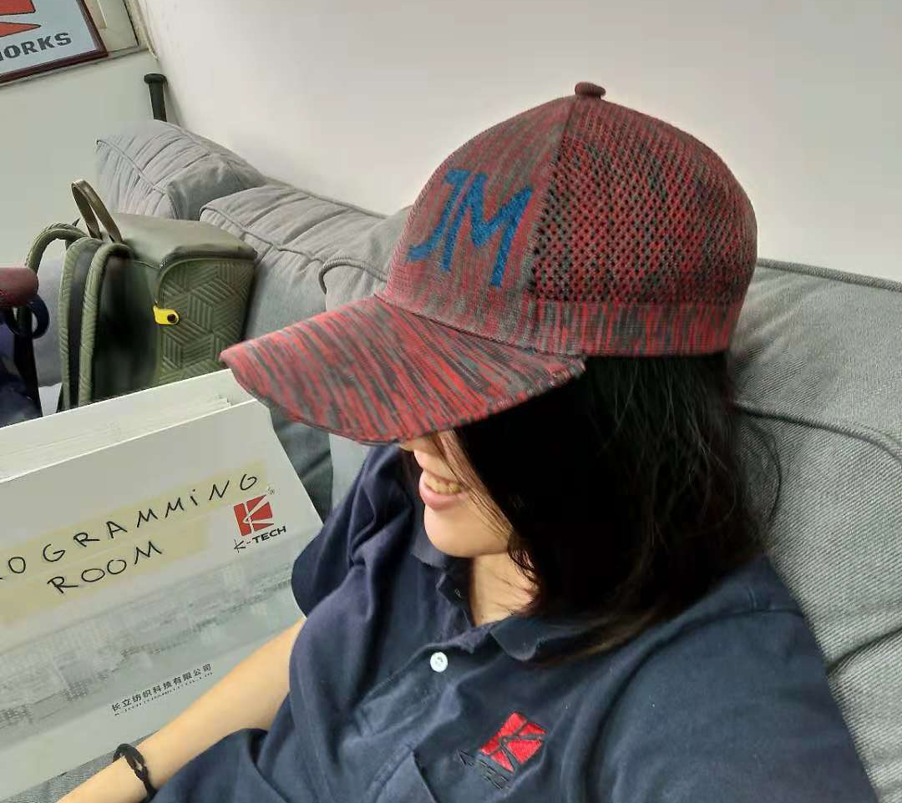
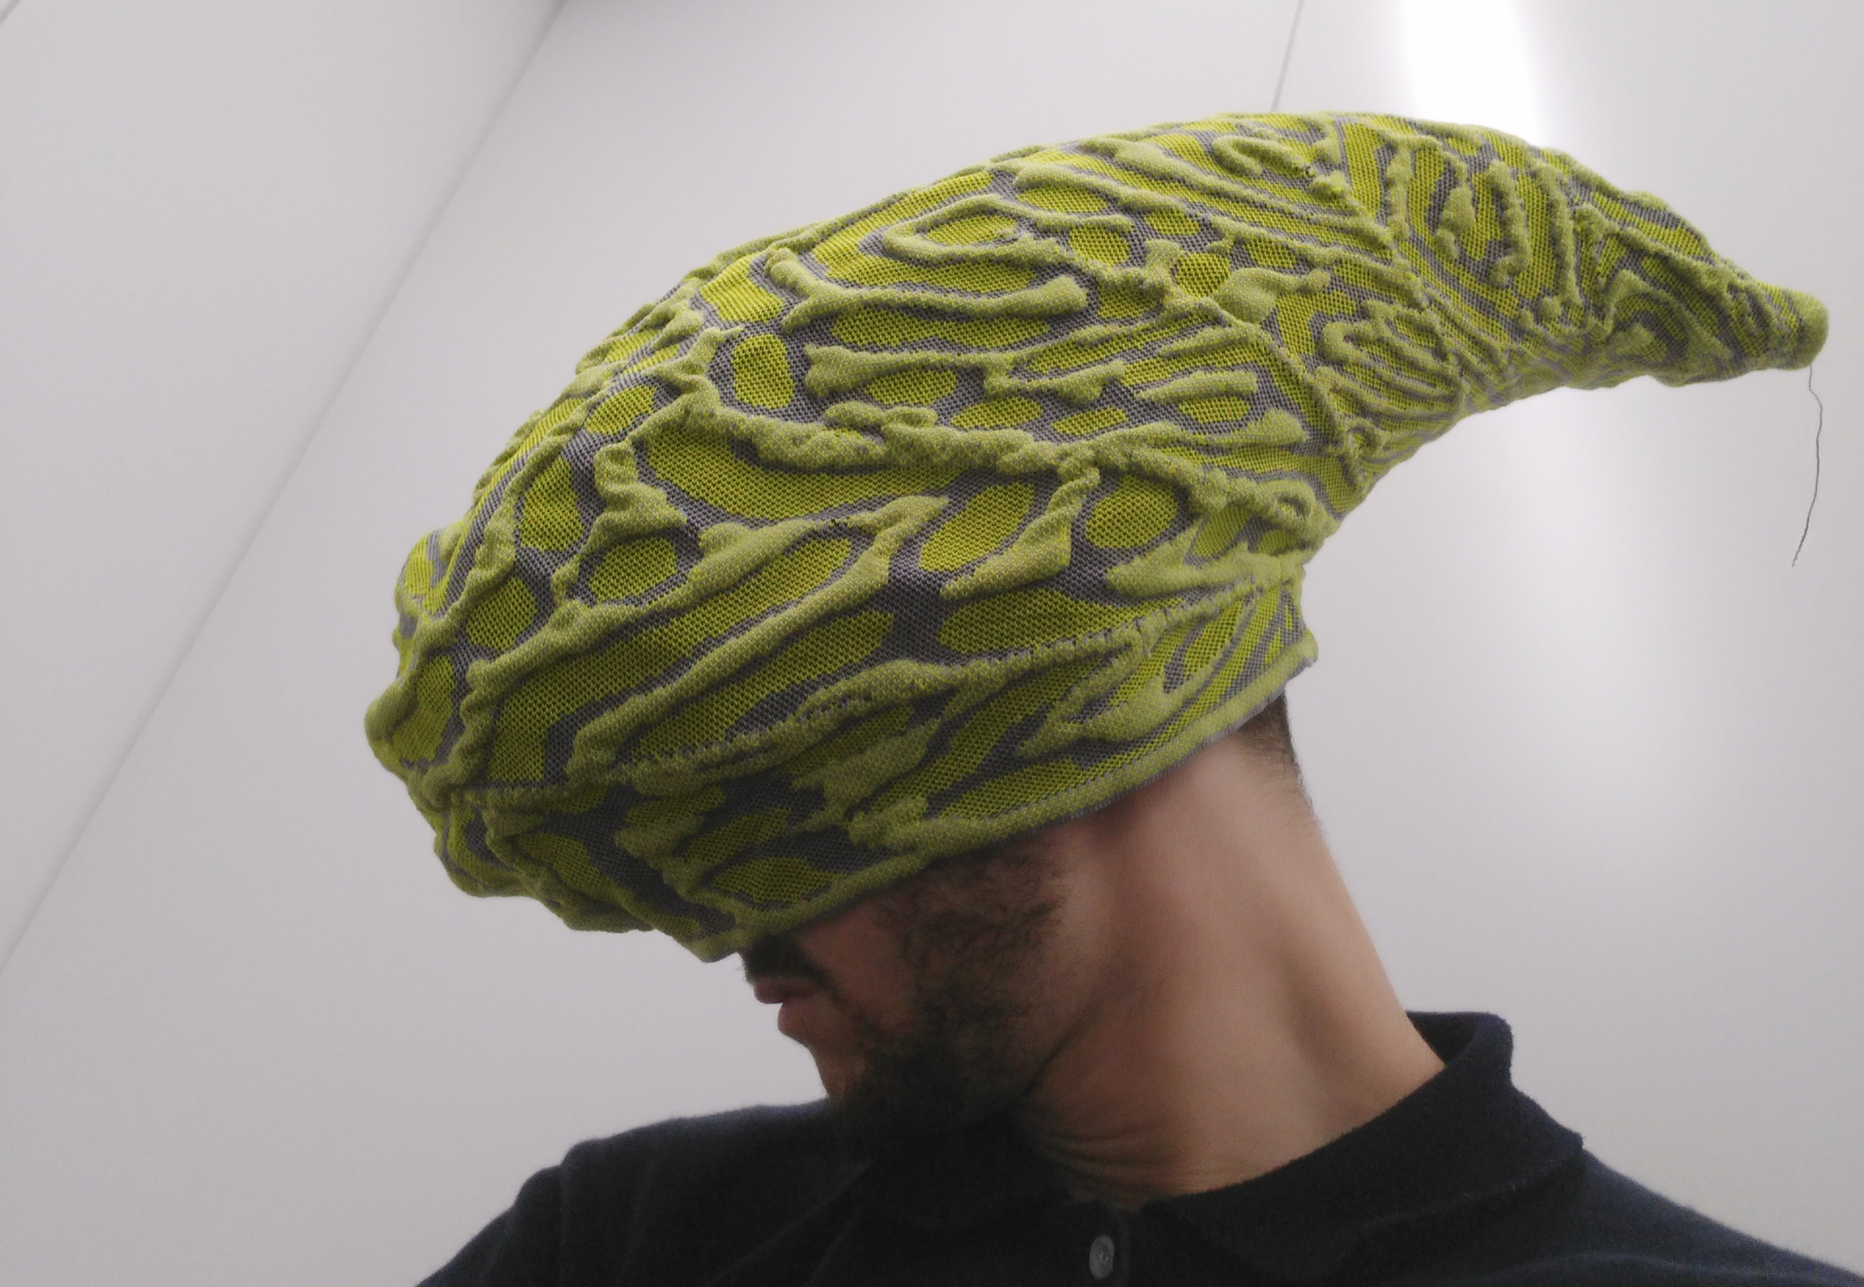
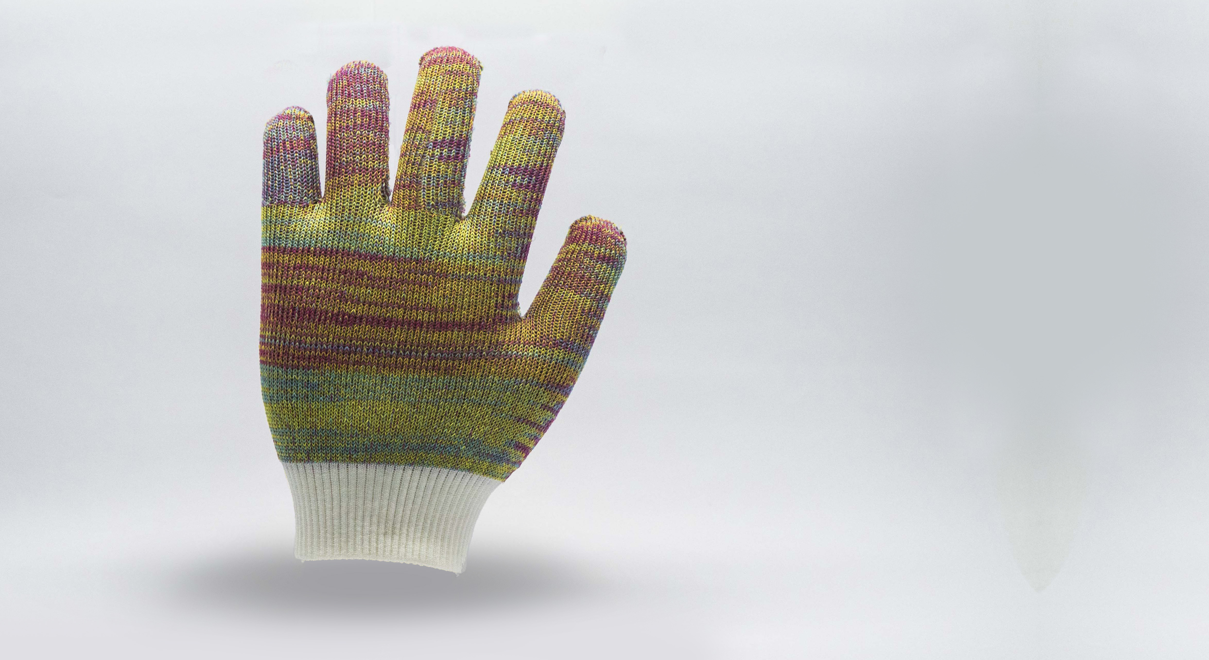
PRODUCTION
INNOVATION

Slide 7
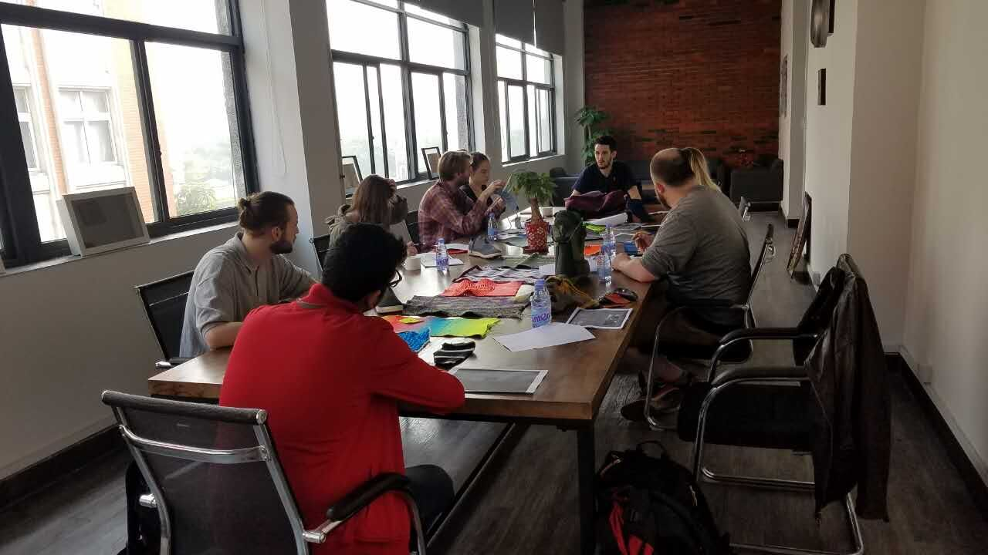
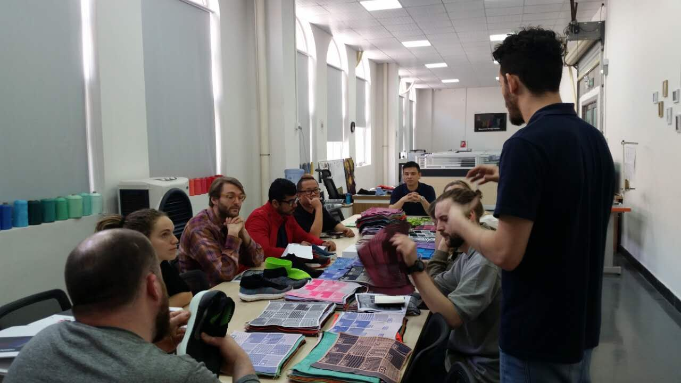
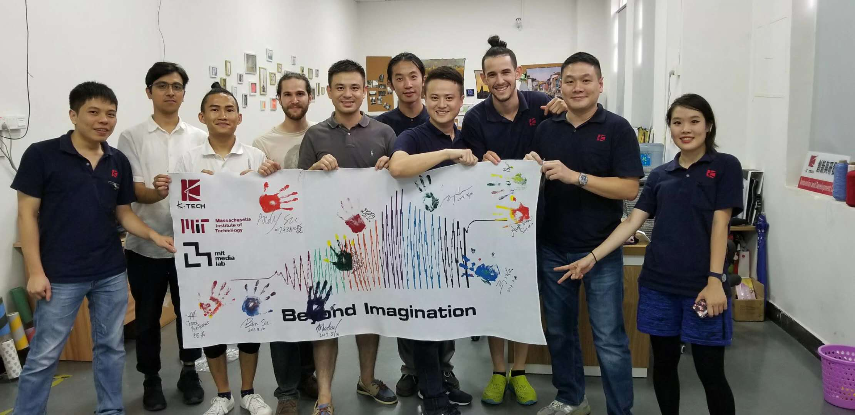
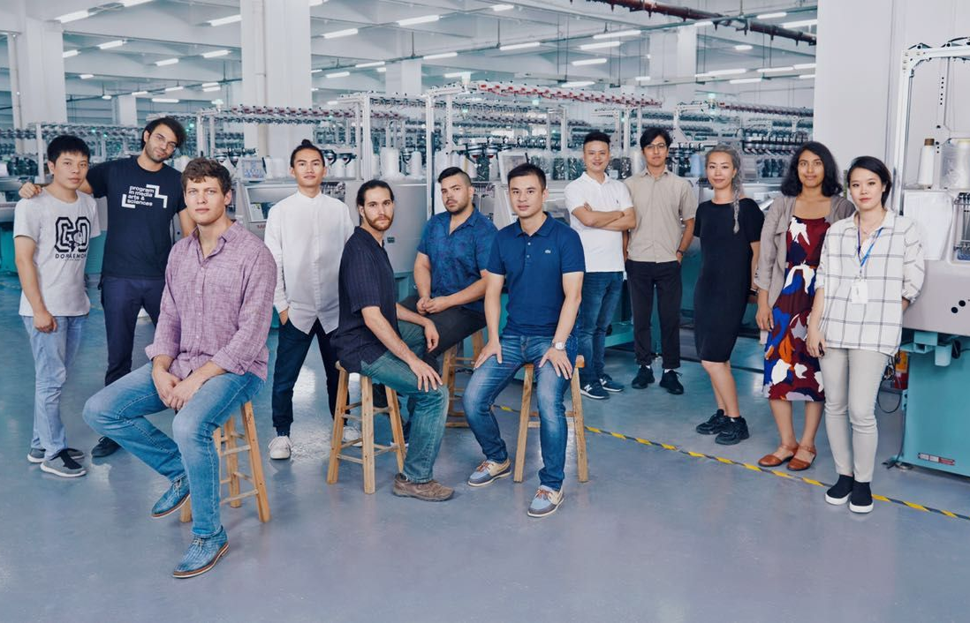
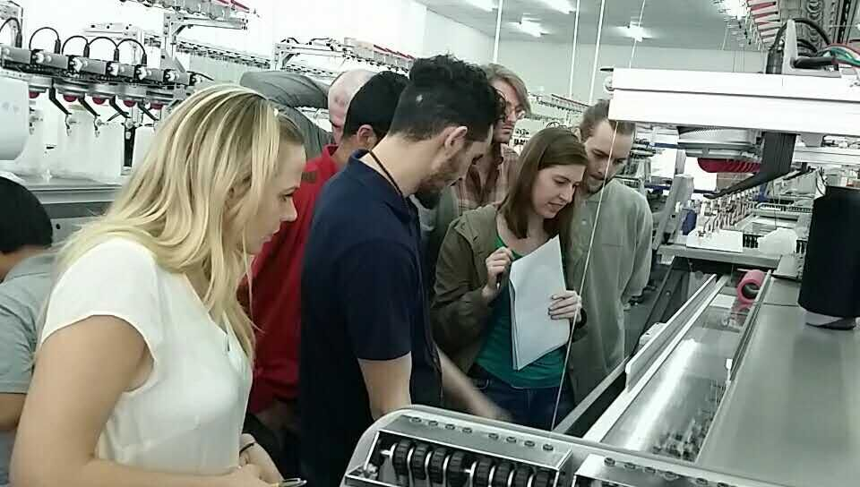
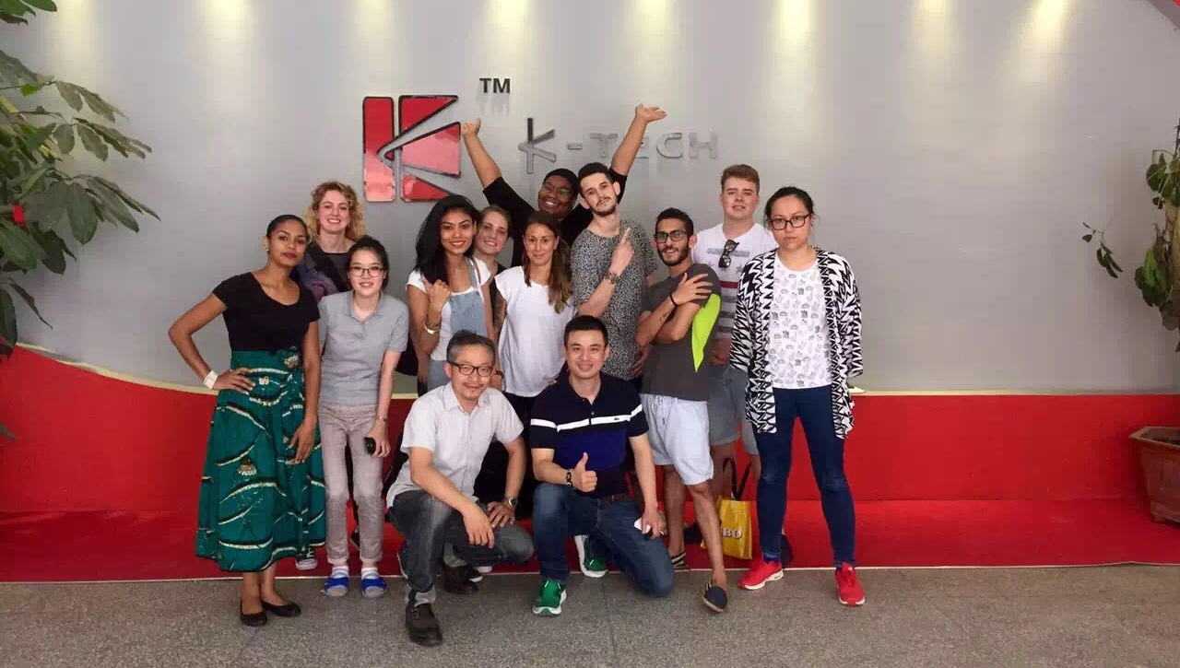
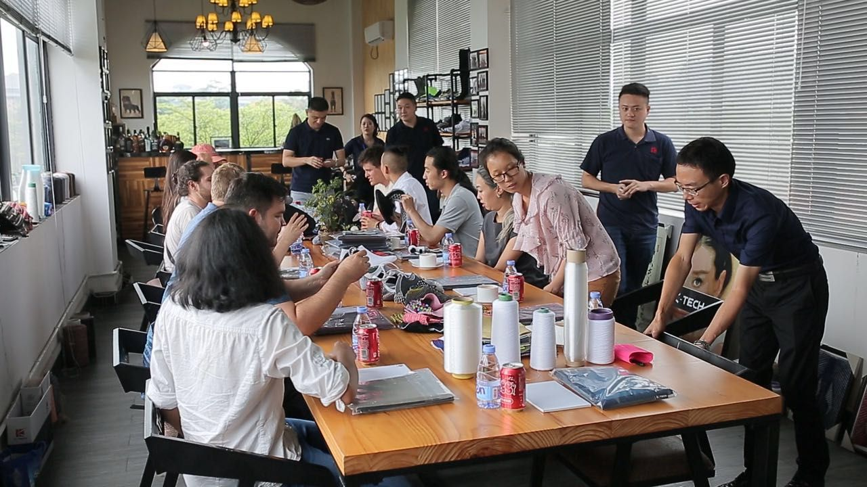
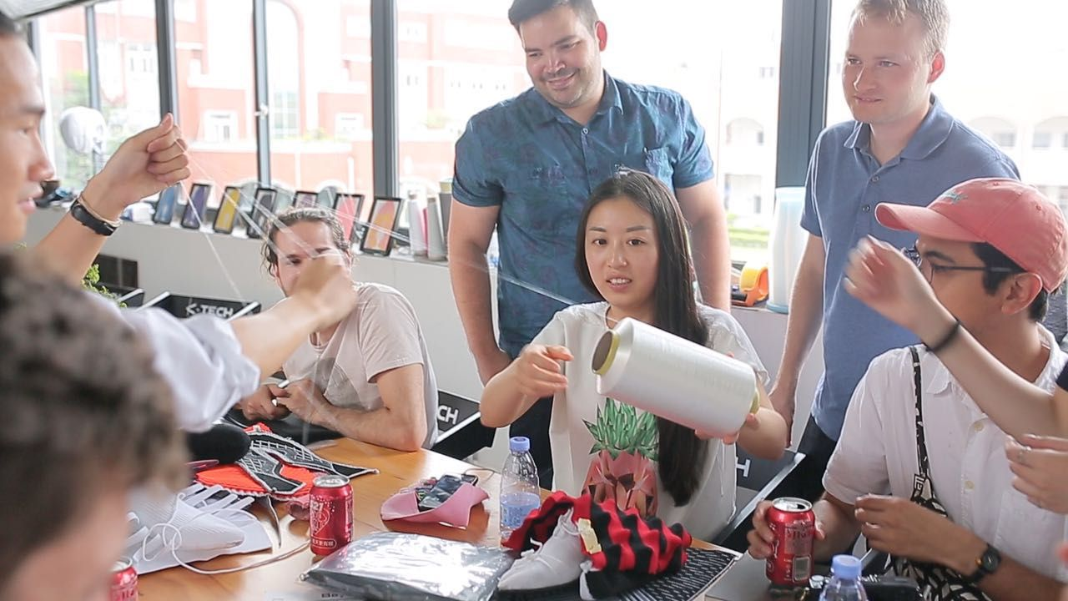
Innovation academic exchange
We are currently collaborating with several footwear academic institution, like FOOTWEARIST in Holland or professional knitting school in Dongguan. This allows us to create a win to win environment of creativity and innovation.
We are also hosting the MIT MediaLab ( Machassusets institude of Technology ) hacking manufacturing course. We work on the development of new materials and applications for those.
We create interactive textiles, smart knits & sustainable materials.

Slide 8
針織開發製作程序
Knitting process
Customer
K-Tech
Shoe factory
開發DEVELOPMENT
開始要件
STARTING POINT
樣品製作
CONSTRUCTION
放碼量產
PRODUCTION
設計 (PDF,PSD,AI)
Artwork Details ( PDF, PSD, Ai )
紙板
Shell pattern file or paper plates
開發編程作業處理
Development of the knitting programming
調機處理
Machine setting & calibration
樣品結構設計
Sample Development
( pattern match )
鞋樣品製作
Shoe Sample ( feedback )
樣品調整
放碼編程製作
量產
Sample adjustments
Size Grading
Mass Production

Slide 9
