Slide 1
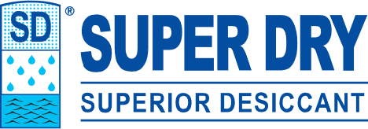
Customer’s logo
Moisture Damage Prevention Primer
What are we really doing??
Treating a defined volume of air.
How to determine that volume = DOSAGE
The best ingredients and why:
Supply chains and ocean shipping create an ideal environment for mold growth which requires:
Uniquely suitable materials
THE GLOBAL EXPERTS IN MOISTURE PROTECTION

Slide 2
Customer’s logo
Principles for Moisture Damage Prevention
1). The volume of air needing protection must be determined.
This defines the amount (weight in grams) of desiccant required.
2). The desiccant must share the same air as the product.
THE GLOBAL EXPERTS IN MOISTURE PROTECTION
Notes:
Download more minimal templates here: https://crmrkt.com/GK9Dwa

Slide 3
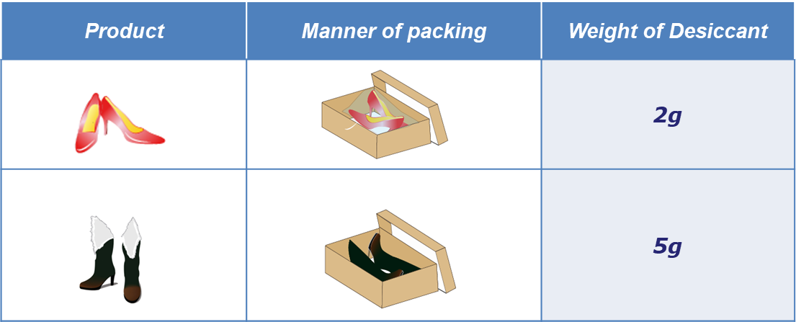
Customer’s logo
Typical Dosages
Packing Method |  |  | Placement Options of Desiccant
 | Individual polybag | sealed | Inside polybag
 |  | unsealed | Inside carton or polybag
 | Master polybag in carton | Sealed or unsealed | Inside master polybag
 | Inner box | With holes or without holes | Inside inner box
 | Carton |  | Inside carton
THE GLOBAL EXPERTS IN MOISTURE PROTECTION
Notes:
Download more minimal templates here: https://crmrkt.com/GK9Dwa

Slide 4
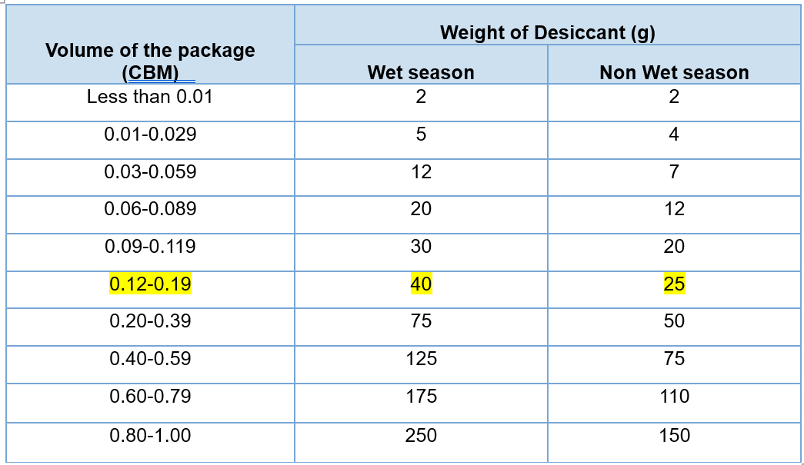
Customer’s logo
No Shoe box? Determining Carton Volume/Dosage – (metric)
Select the desiccant dosage based on your package size
Package refers to carton, inner box or poly bag, etc.
Our desiccants come in different sizes (weights), i.e. 2g, 5g, 10g, 25g, 50g, and 100g. They can be combined to reach the required amount needed.
EXAMPLE
Carton Size = 85cm. X 34cm. X 53cm. = 0.153cbm
Recommendation: 40 grams wet season, 25 grams dry season
THE GLOBAL EXPERTS IN MOISTURE PROTECTION
Notes:
Download more minimal templates here: https://crmrkt.com/GK9Dwa

Slide 5
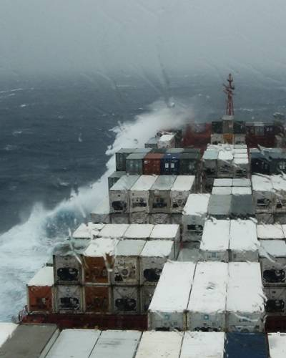
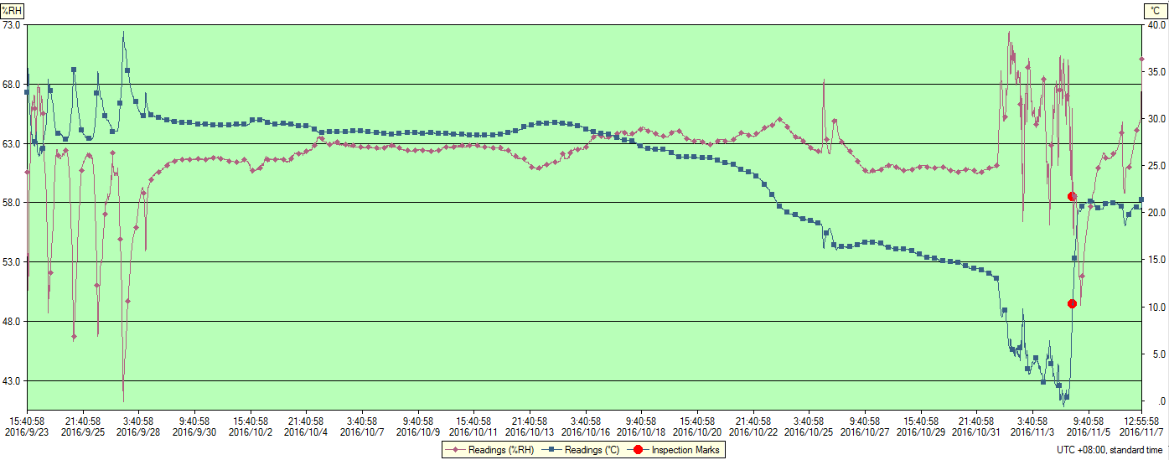
It’s rough out there.
Customer’s logo
But inside the container is worse!
Real-time (log tag) changes in temperature and humidity inside the container during a 46-day ocean transit.
THE GLOBAL EXPERTS IN MOISTURE PROTECTION
Notes:
Download more minimal templates here: https://crmrkt.com/GK9Dwa

Slide 6
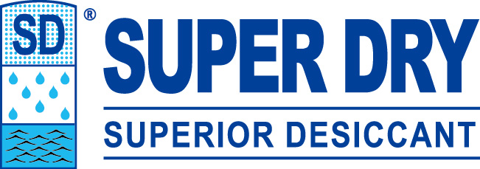
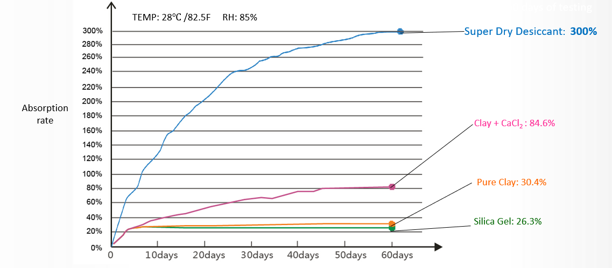
Customer’s logo
Desiccant Ingredient Comparison
THE GLOBAL EXPERTS IN MOISTURE PROTECTION
Notes:
Download more minimal templates here: https://crmrkt.com/GK9Dwa

Slide 7
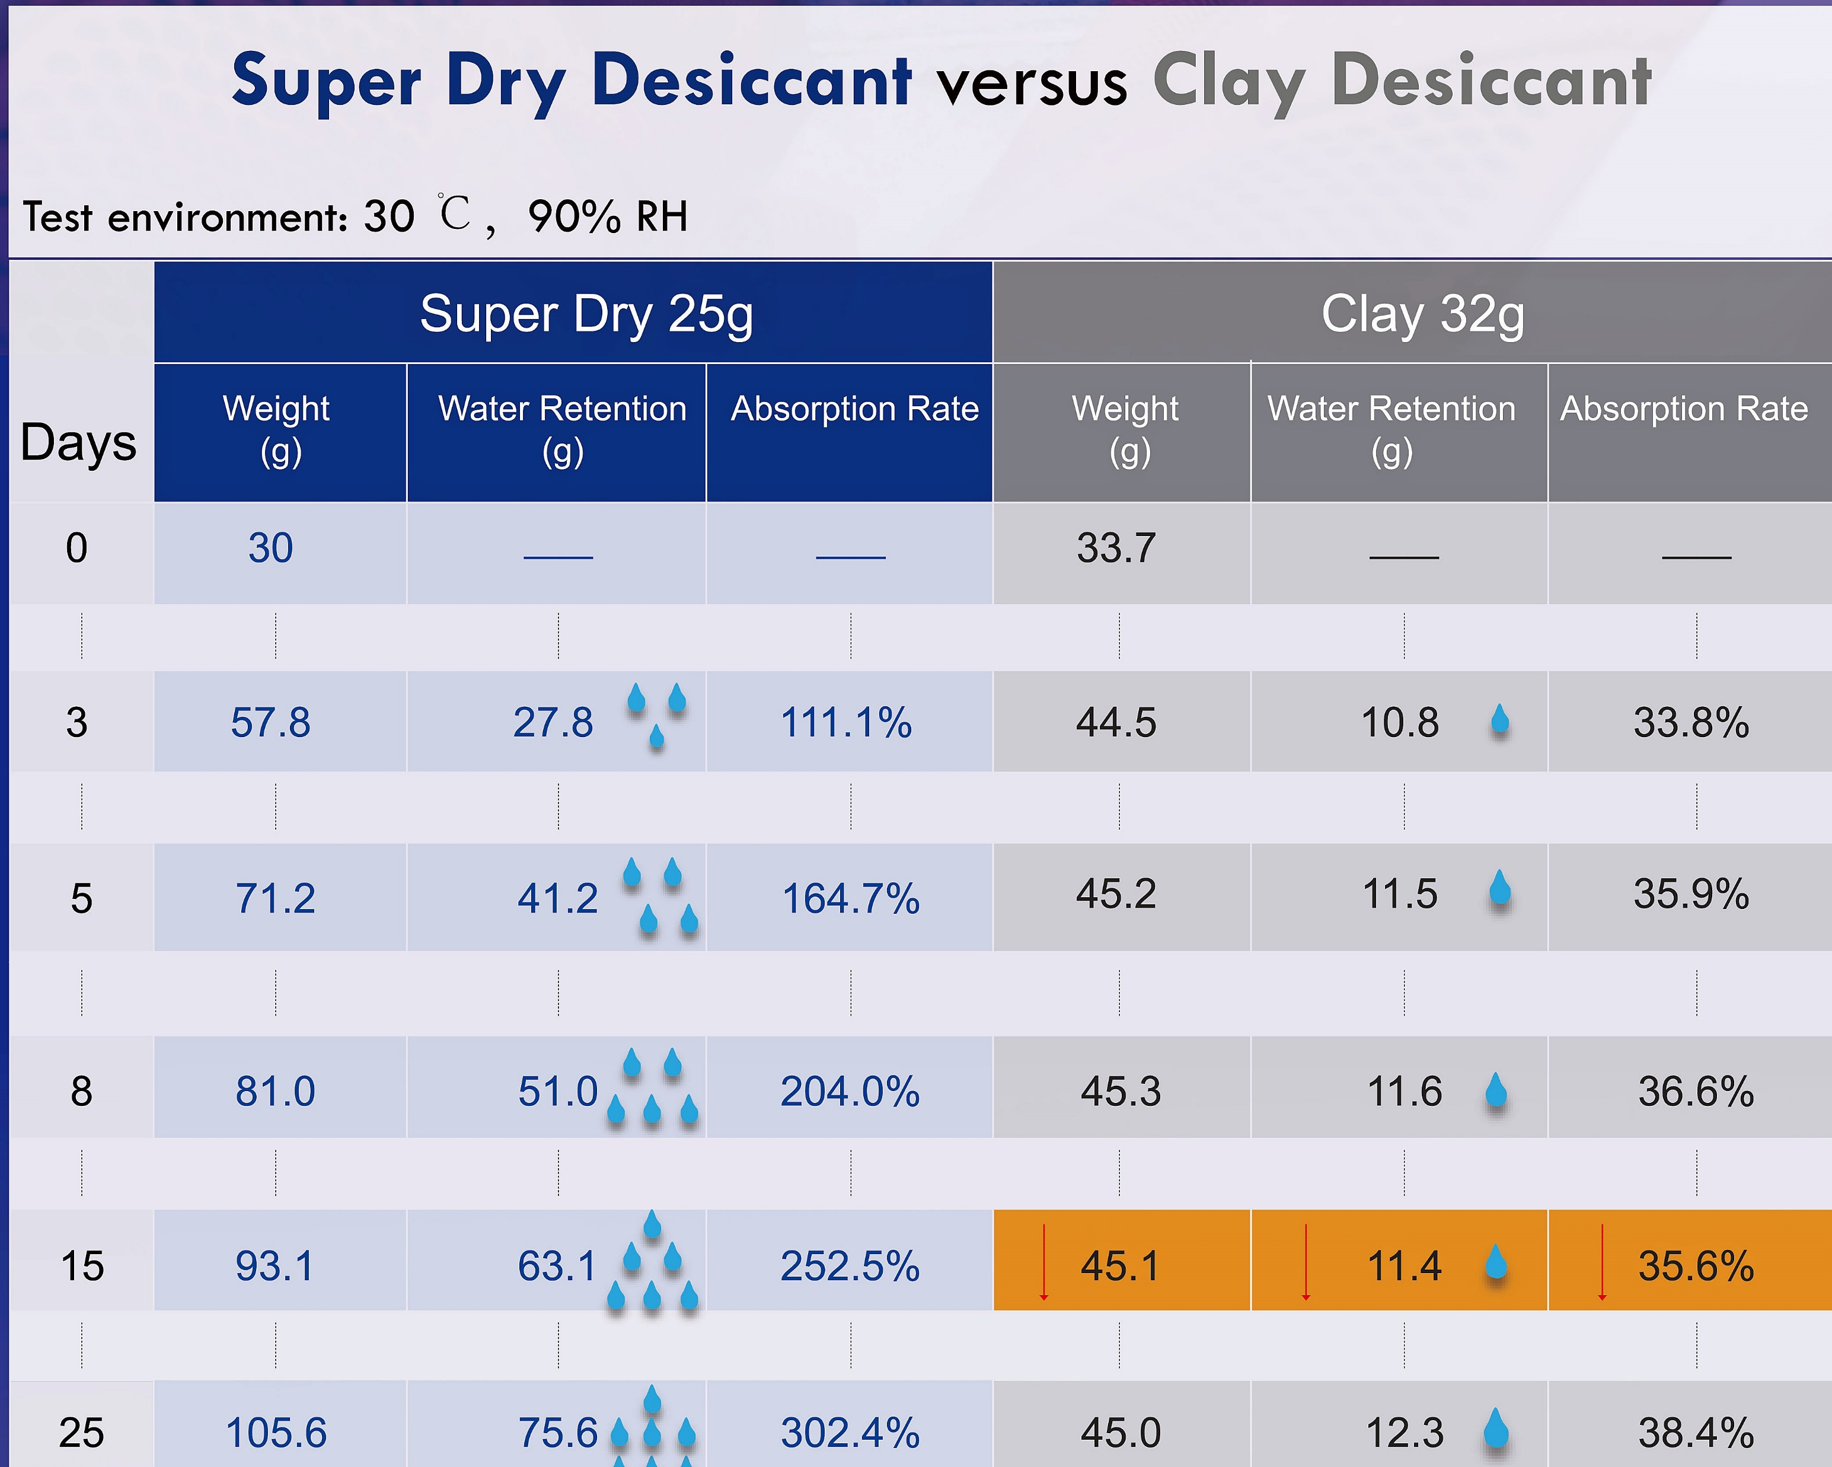
Customer’s logo
Why is the desiccant ingredient important?
SD absorbs nearly 3 times the amount of water vapor ending day 3, 6 times overall.
Clay absorbs little after day 3.
Clay outgasses water vapor into the cargo environment (day 15)
Super Dry typical effectiveness 60-120 days depending on conditions.
THE GLOBAL EXPERTS IN MOISTURE PROTECTION

Slide 8
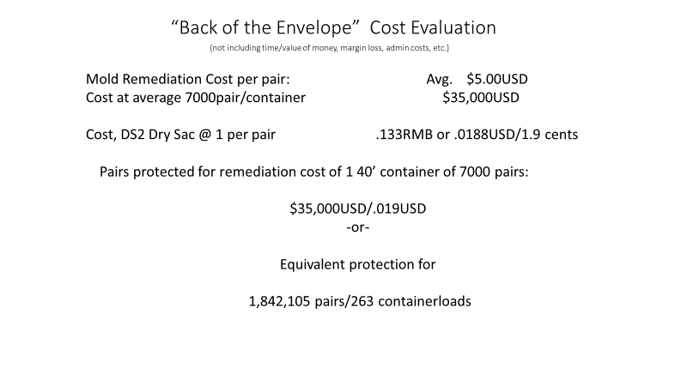
Customer’s logo
THE GLOBAL EXPERTS IN MOISTURE PROTECTION
Notes:
Download more minimal templates here: https://crmrkt.com/GK9Dwa

Slide 9
Customer’s logo
Contacts
Name : Michael Hanrahan
SVP, Superdry Int’l Americas
Phone : 201 679 4703
Email : michael@superdryers.com
Name : Steve Ryan
VP, Mid-West Region,
Super Dry Int’l Americas
Phone : 312 371 5438
Email : steve@superdryers.com
Name : Mike Mickle
Desicca LLC – US Distributor
Phone : 904 742 1106
Email : admin@superdryamericas.com
Name : Fred Birnbaum (Hong Kong) EVP & CCO at Super Dry International
Phone : (852) 9542 4019
Email : fred@superdryers.com
Global Contact List Available Upon Request
THE GLOBAL EXPERTS IN MOISTURE PROTECTION

